Slide 1
AZ-400.00 Learning Path 03: Design and implement a release strategy

Slide 2
Agenda
Module 01: Create a release pipeline.
Module 02: Explore release recommendations.
Module 03: Provision and test environments.
Module 04: Manage and modularize tasks and templates.
Module 05: Multi-stage YAML.
Module 06: Automate inspection of health.
Labs & Learning Path review and takeaways.

Slide 3
Module 01: Create a release pipeline

Slide 4
Explore release pipelines

Slide 5
Examine considerations for deployment to stages
Do we want/need to deploy every day?
What is your target environment?
Is it used by one team or is it used by multiple teams?
Who are the users? Do they want a new version multiple times a day?
How long does it take to deploy?
Is there downtime? What happens to performance? Are users impacted?

Slide 6
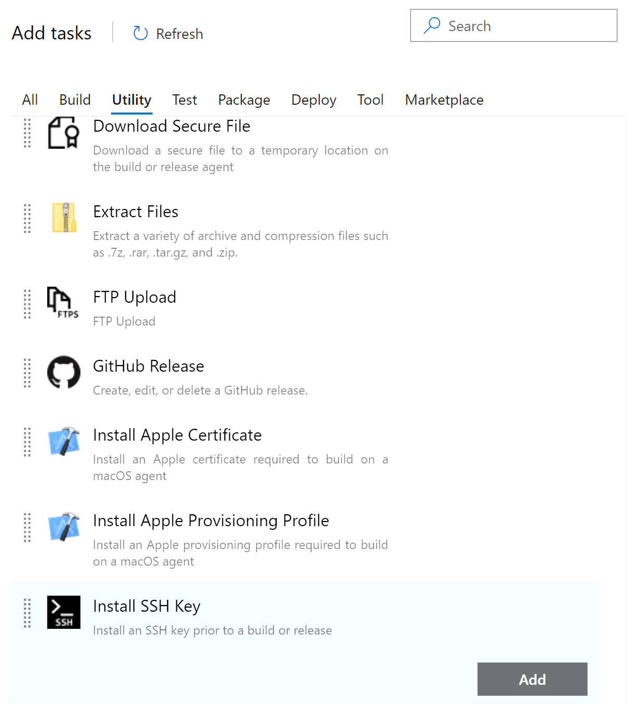
Explore build and release tasks
Units of executable code used to perform designated actions in a specified order
Tasks building, testing, running utilities, packaging, and deploying
Extensible model
Community tasks available in marketplace

Slide 7
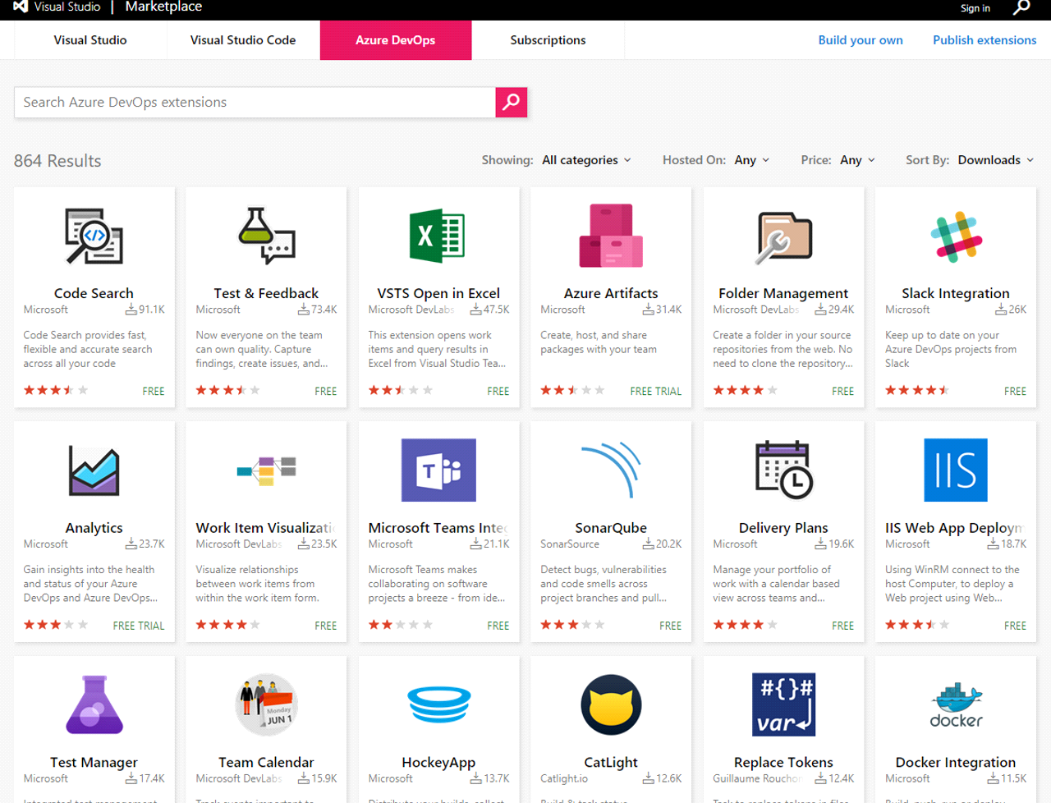
Explore custom build and release tasks
Private or public accessible
Access to variables that are otherwise not accessible
Use and reuse secure endpoint to a target server
Safely and efficiently distribute across your whole organization
Users do not see implementation details

Slide 8
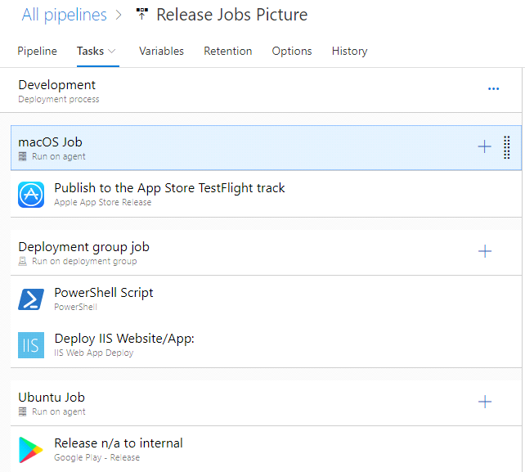
Explore release jobs
A job is a series of tasks that run sequentially on the same target
Can be combined in one pipeline to enable multi-platform deployment:
E.g., deploy .NET backend via Windows, iOS app via MacOS and Angular frontend via Linux
Jobs run on the host machine where the agent is installed

Slide 9
Understand database deployment task
Consider the following for database deployment automation:
Key provisions | Implementation tasks and tools | SQL Server and Azure SQL-specific techniques and tools
Data separation | Creating database deployment scripts | SQL Server Data Tools (SSDT)
Data preservation | Storing database connection strings securely | SQLPackage.exe
Idempotent operations | Using Azure DevOps tasks or third-party extensions | Azure DevOps Tasks
Versioning and rollback | Configuring dependencies and tools | Azure Command-Line Interface (CLI)
Testing and validation | Including database testing tasks | SQL Server Management Studio (SSMS)
Monitoring and alerting | Implementing rollback and recovery mechanisms | Entity Framework (EF)
Notes:
Another tool or technique that can be leveraged when working with SQL Server or Azure SQL Database in CI/CD pipelines is custom scripts such as PowerShell, Bash, or SQL scripts that automate database deployment tasks in CI/CD pipelines.

Slide 10
Module 02: Explore release recommendations

Slide 11
Understand the delivery cadence and three types of triggers
Continuous deployment trigger
Scheduled trigger
Manual trigger

Slide 12
Explore release approvals
Release approvals are not to control how, but control if you want to deliver multiple times a day
Manual Approvals help in building trust about the automated release process
Release gates give you additional control over the start and completion of the deployment pipeline. They can usually be set up as a pre-deployment and post-deployment condition and can perform validation with other automated systems until specific requirements are verified.

Slide 13
Use release gates to protect quality
No new blocker issues
Code coverage on new code greater than 80%
No license violations
No vulnerabilities in dependencies
No new technical debt introduced
Compliance checks
Are there work items linked to the release?
Is the release started by someone else as the code committer?
Is the performance not affected after a new release?

Slide 14
Module 03: Provision and test environments

Slide 15
Provision and configure target environments
On-premises servers
Cloud servers or Infrastructure as a Service (IaaS). For example, virtual machines or networks
Platform as a Service (PaaS) and Functions as a Service (FaaS). For example, Azure SQL Database in both PaaS and Serverless options
Clusters
Service connections

Slide 16
Set up and run availability tests
Create health end points in your application
Use tools, e.g., availability tests in Application Insights, to test health endpoints
Two common types of availability tests:
URL ping test
Multi-step web test

Slide 17
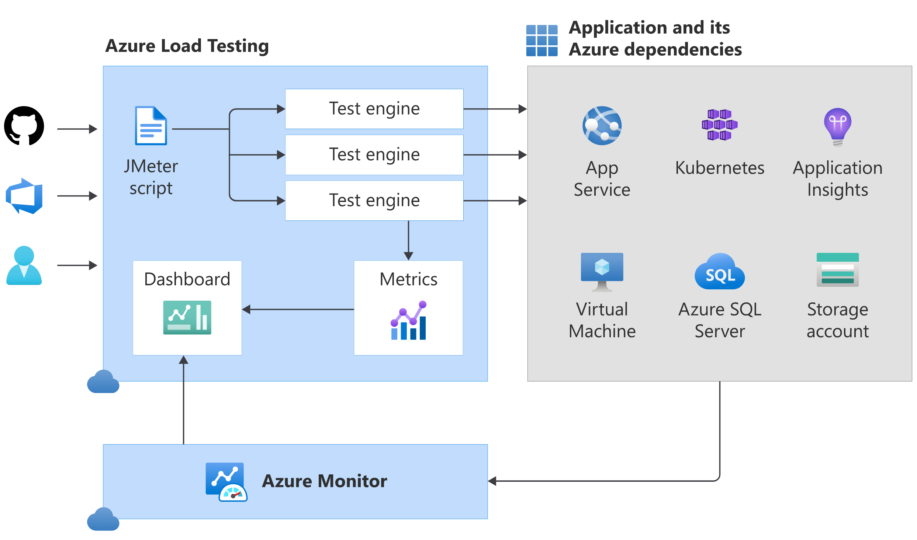
Explore Azure Load Testing
Azure Load Testing is a fully managed load-testing service that enables you to generate high-scale load.
Integrate Azure Load Testing in your CI/CD pipeline during the development lifecycle.
Notes:
Explain Azure Load Testing: https://docs.microsoft.com/en-us/azure/load-testing/overview-what-is-azure-load-testing
Azure Load Testing is a fully managed load-testing service that enables you to generate high-scale load.
The service simulates traffic for your applications, helping you to optimize application performance, scalability, or capacity.
You can create a load test using existing test scripts based on Apache JMeter. Azure Load Testing abstracts the infrastructure to run your JMeter script and load test your application.
For Azure-based applications, Azure Load Testing collects detailed resource metrics to help you identify performance bottlenecks (https://docs.microsoft.com/en-us/azure/load-testing/tutorial-identify-bottlenecks-azure-portal) across your Azure application components.
You can automate regression testing (https://docs.microsoft.com/en-us/azure/load-testing/overview-what-is-azure-load-testing#enable-automated-load-testing) by running load tests as part of your continuous integration and continuous deployment (CI/CD) workflow.
You can automatically run a load test at the end of each sprint or in a staging environment to validate a release candidate build.
You can trigger Azure Load Testing from Azure Pipelines or GitHub Actions workflows.

Slide 18
Module 04: Manage and modularize tasks and templates

Slide 19
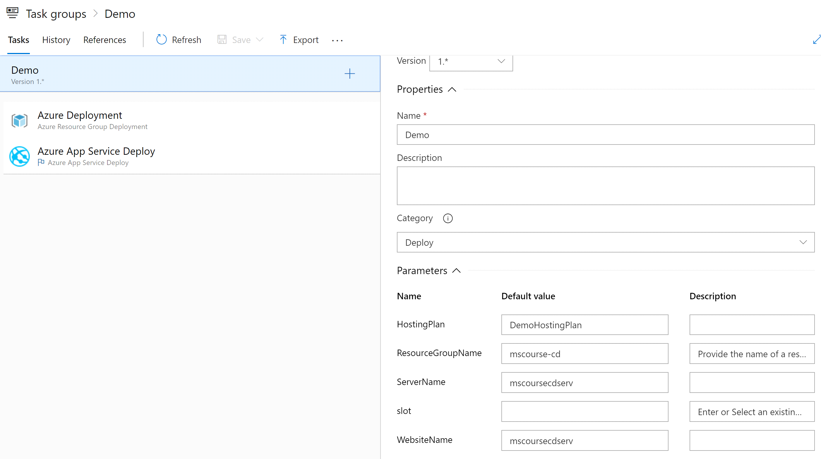
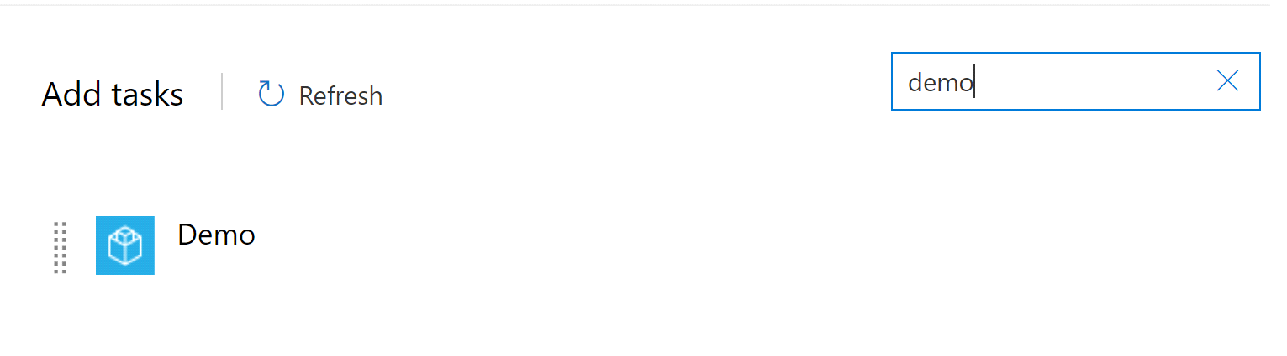
Examine task groups
Encapsulate a sequence of tasks in one reusable task
Parameterization of task groups to make reuse easier
Standardize and centrally manage deployment steps for all your applications
Note: Task groups are not currently supported in YAML. Use templates instead.

Slide 20
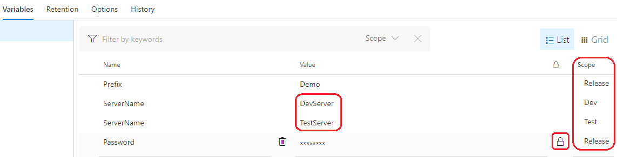
Explore variables in release pipelines
Predefined Variables
Pipeline variables
Stage Variables
Variable groups
Normal and Secret variables

Slide 21
Understand variable groups
A variable group is used to store values that you want to make available across multiple builds and release pipelines:
Store the username and password for a shared server
Store a share connection string
Store the geolocation of an application
Store all settings for a specific application

Slide 22
Module 05: Multi-stage YAML

Slide 23
Describe Deployment Jobs strategies
Enable initialization
Deploy the update
Route traffic to the updated version
Test the updated version after routing traffic
If there’s a failure, run steps to restore to the last known good version
Notes:
For details about Deployment Jobs Strategies, see https://docs.microsoft.com/azure/devops/pipelines/process/deployment-jobs?view=azure-devops#deployment-strategies.
Deployment strategies allow you to use specific techniques to deliver updates when deploying your application.
Techniques examples:
Enable initialization.
Deploy the update.
Route traffic to the updated version.
Test the updated version after routing traffic.
In case of failure, run steps to restore to the last known good version.
You can achieve this by using lifecycle hooks that run steps during the deployment.

Slide 24
Describe lifecycle hooks
preDeploy – Used to run steps that initialize resources before application deployment starts.
deploy – Used to run steps that deploy your application.
routeTraffic – Used to run steps that serve the traffic to the updated version.
postRouteTraffic – Used to run the steps after the traffic is routed.
on: failure or on: success – Used to run steps for rollback actions or clean-up.
Notes:
For details about Lifecycle hooks, seehttps://docs.microsoft.com/azure/devops/pipelines/process/deployment-jobs?view=azure-devops#deployment-strategies.
preDeploy: Used to run steps that initialize resources before application deployment starts.
deploy: Used to run steps that deploy your application. Download artifact task will be auto injected only in the deploy hook for deployment jobs. To stop downloading artifacts, use - download: none or choose specific artifacts to download by specifying https://docs.microsoft.com/en-us/azure/devops/pipelines/tasks/utility/download-pipeline-artifact?view=azure-devops.
routeTraffic: Used to run steps that serve the traffic to the updated version.
postRouteTraffic: Used to run the steps after the traffic is routed. Typically, these tasks monitor the health of the updated version for defined interval.
on: failure or on: success: Used to run steps for rollback actions or clean-up.

Slide 25
Explore deployment jobs strategies – RunOnce
strategy:
runOnce:
preDeploy:
pool: [ server | pool ] # See pool schema.
steps:
- script: [ script | bash | pwsh | powershell | checkout | task | templateReference ]
deploy:
pool: [ server | pool ]
steps:
. . .
routeTraffic:
pool: [ server | pool ]
steps:
. . .
postRouteTraffic:
pool: [ server | pool ]
steps:
. . .
on:
failure:
pool: [ server | pool ]
steps:
. . .
success:
pool: [ server | pool ]
steps:
. . .
runOnce is the simplest deployment strategy wherein all the lifecycle hooks are executed:
preDeploy
deploy
routeTraffic
postRouteTraffic
Then, either on: success or on: failure is executed.
Notes:
For details about Deployment Jobs Strategies, see https://docs.microsoft.com/azure/devops/pipelines/process/deployment-jobs?view=azure-devops#deployment-strategies.
runOnce is the simplest deployment strategy wherein all the lifecycle hooks, namely preDeploy deploy, routeTraffic, and postRouteTraffic, are executed once. Then, either on: success or on: failure is executed.
strategy:
runOnce:
preDeploy:
pool: [ server | pool ] # See pool schema.
steps:
- script: [ script | bash | pwsh | powershell | checkout | task | templateReference ]
deploy:
pool: [ server | pool ] # See pool schema.
steps:
...
routeTraffic:
pool: [ server | pool ]
steps:
...
postRouteTraffic:
pool: [ server | pool ]
steps:
...
on:
failure:
pool: [ server | pool ]
steps:
...
success:
pool: [ server | pool ]
steps:
...

Slide 26
Explore deployment jobs strategies – Rolling
strategy:
rolling:
maxParallel: [ number or percentage as x% ]
preDeploy:
steps: [ script | bash | pwsh | powershell | checkout | task | templateReference ]
deploy:
steps:
. . .
routeTraffic:
steps:
. . .
postRouteTraffic:
steps:
. . .
on:
failure:
steps:
. . .
success:
steps:
. . .
A rolling deployment replaces instances of the previous version of an application with instances of the new version.
It can be configured by specifying the keyword rolling: under the strategy: node.
Notes:
For details about Deployment Jobs Strategies, see https://docs.microsoft.com/azure/devops/pipelines/process/deployment-jobs?view=azure-devops#deployment-strategies.
A rolling deployment replaces instances of the previous version of an application with instances of the new version. It can be configured by specifying the keyword rolling: under the strategy: node.
strategy:
rolling:
maxParallel: [ number or percentage as x% ]
preDeploy:
steps:
- script: [ script | bash | pwsh | powershell | checkout | task | templateReference ]
deploy:
steps:
...
routeTraffic:
steps:
...
postRouteTraffic:
steps:
...
on:
failure:
steps:
...
success:
steps:
...

Slide 27
Explore deployment jobs strategies – Canary
strategy:
canary:
increments: [ number ]
preDeploy:
pool: [ server | pool ] # See pool schema.
steps:
- script: [ script | bash | pwsh | powershell | checkout | task | templateReference ]
deploy:
pool: [ server | pool ]
steps:
. . .
routeTraffic:
pool: [ server | pool ]
steps:
. . .
postRouteTraffic:
pool: [ server | pool ]
steps:
. . .
on:
failure:
pool: [ server | pool ]
steps:
. . .
success:
pool: [ server | pool ]
steps:
. . .
Advanced deployment strategy that helps mitigate the risk involved in rolling out new versions of applications.
Roll out the changes to a small subset of servers first.
Release it to more servers in your infrastructure and route more traffic to it.
Notes:
For details about Deployment Jobs Strategies, seehttps://docs.microsoft.com/azure/devops/pipelines/process/deployment-jobs?view=azure-devops#deployment-strategies.
By using this strategy, you can roll out the changes to a small subset of servers first. The canary deployment strategy is an advanced deployment strategy that helps mitigate the risk involved in rolling out new versions of applications.
As you gain more confidence in the new version, you can release it to more servers in your infrastructure and route more traffic to it.
strategy:
canary:
increments: [ number ]
preDeploy:
pool: [ server | pool ] # See pool schema.
steps:
- script: [ script | bash | pwsh | powershell | checkout | task | templateReference ]
deploy:
pool: [ server | pool ] # See pool schema.
steps:
...
routeTraffic:
pool: [ server | pool ]
steps:
...
postRouteTraffic:
pool: [ server | pool ]
steps:
...
on:
failure:
pool: [ server | pool ]
steps:
...
success:
pool: [ server | pool ]
steps:
...

Slide 28
Module 06: Automate inspection of health

Slide 29
Automate inspection of health
Stay informed about your process and releases:
Release gates
Events, subscriptions, and notifications
Service hooks
Reporting

Slide 30
Explore events and notifications
Actions in Azure DevOps trigger events
Users can subscribe to events and get notified receiving an email
Notifications can be managed centrally and personally

Slide 31
Explore service hooks
Service hooks enable you to perform tasks on other services when events happen
Out of the box integrations
Build and release | Collaborate | Customer support | Plan and track | Integrate
AppVeyor | Campfire | UserVoice | Trello | Azure Service Bus
Bamboo | Flowdock | Zendesk |  | Azure Storage
Jenkins | HipChat |  |  | Web Hooks
MyGet | Hubot |  |  | Zapier
Slack

Slide 32
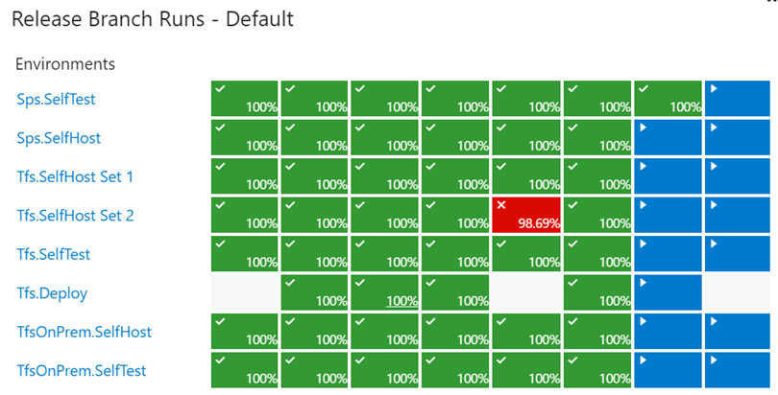
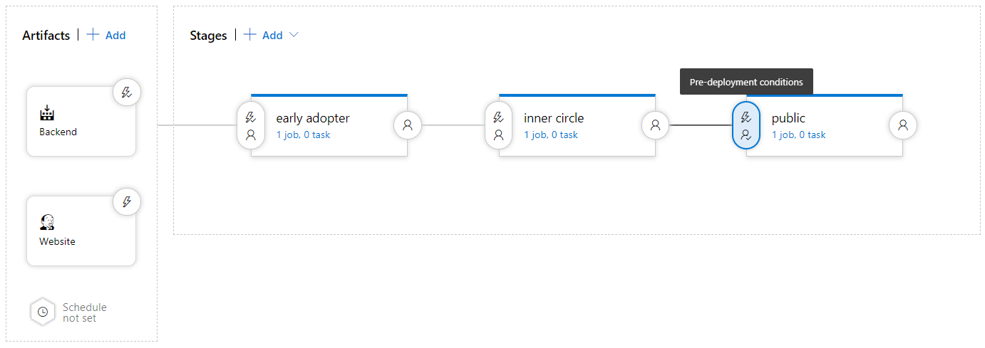
Explore how to measure quality of your release process
Visualize your release process
Symptoms of broken process (every second day, only after rerun, never ending up in last stage)
Dashboard widgets

Slide 33
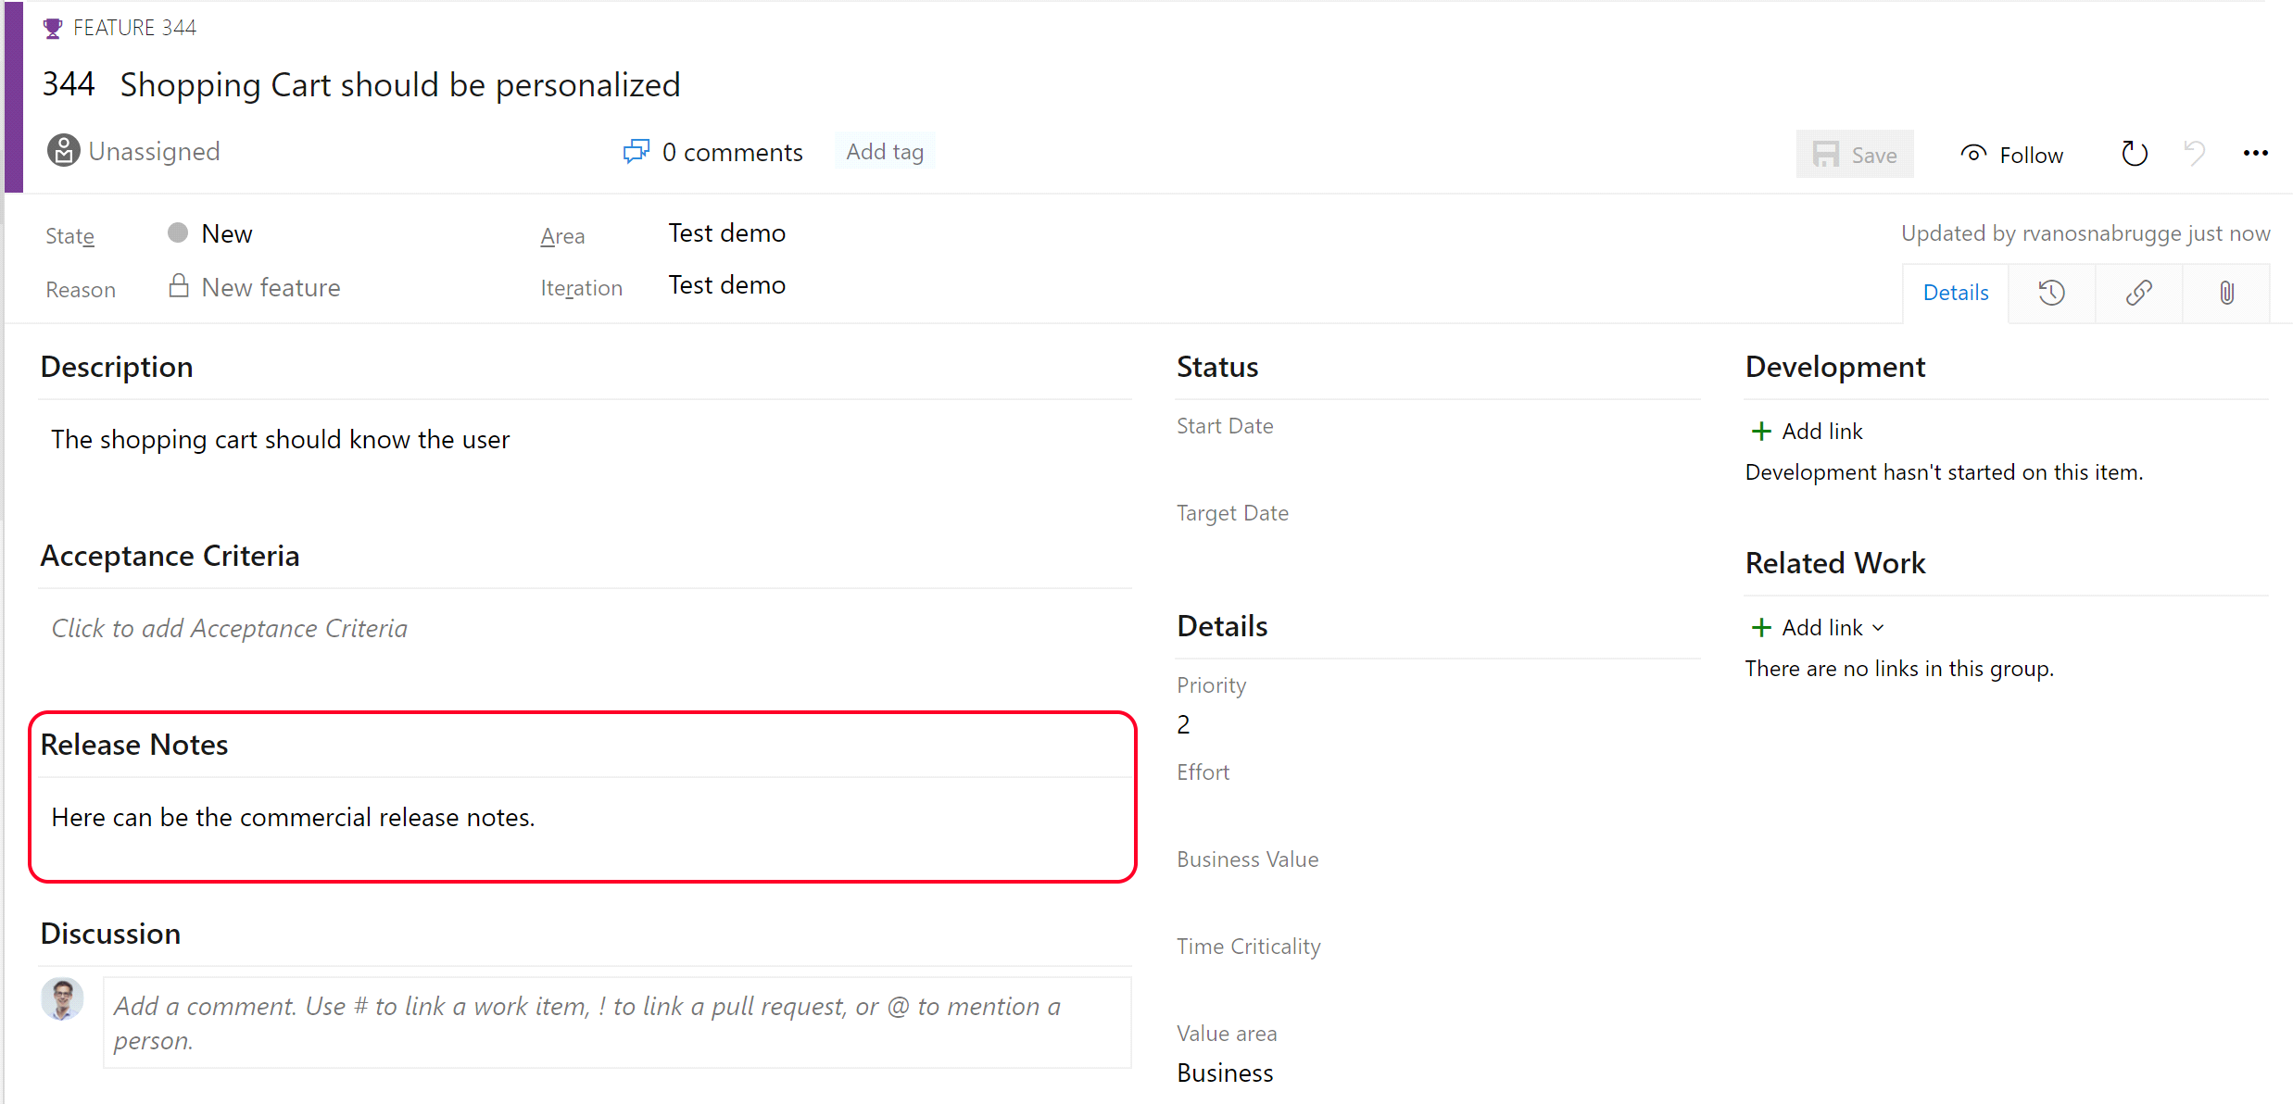
Examine release notes and documentation
Technical or Functional Documentation?
Where to store Documentation:
Document Store
Wiki
In the code base
In a Work Item

Slide 34
Examine considerations for choosing release management tools
Artifacts and artifact source
Triggers and schedules
Approvals and gates
Stages
Build and release tasks
Traceability, auditability and security

Slide 35

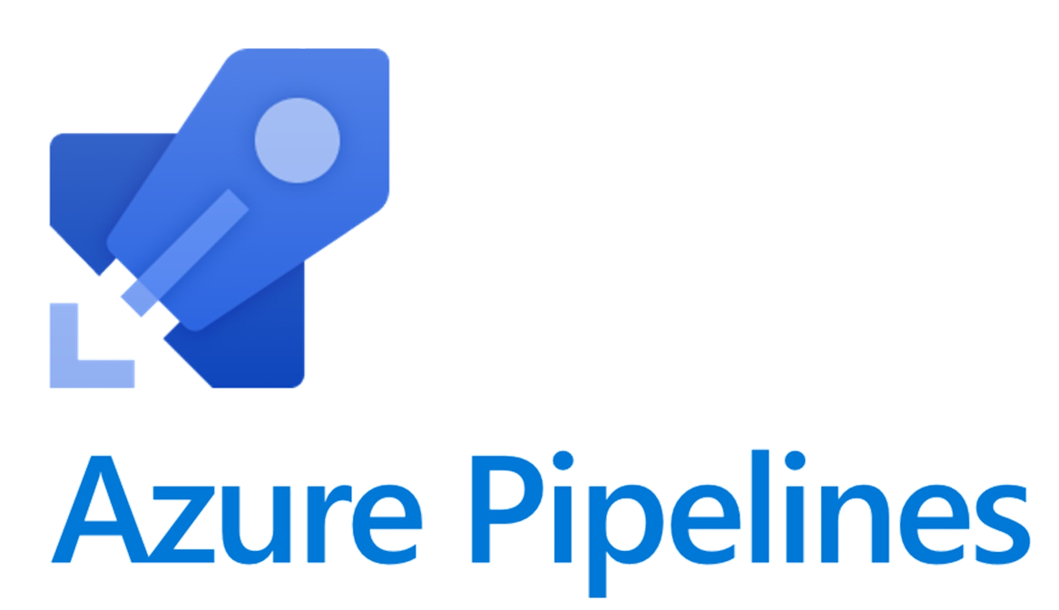




Explore common release management tools
GitHub Actions
GitHub
Azure Pipelines
Jenkins
Circle CI
GitLab Pipelines
Atlassian Bamboo

Slide 36
Labs

Slide 37
Lab: Configuring pipelines as code with YAML
Objectives:
Lab overview:
Azure DevOps also provides default templates for popular project types, as well as a YAML designer to simplify the process of defining build and release tasks.
Configure CI/CD pipelines as code with YAML in Azure DevOps
Duration:
Notes:
The labs are updated on a regular basis. For the latest information please visit:
https://microsoftlearning.github.io/AZ400-DesigningandImplementingMicrosoftDevOpsSolutions/

Slide 38
Lab: Controlling deployments using Release Gates
Objectives:
Configure release pipelines
Configure release gates
Test release gates
Lab overview:
This lab covers the configuration of the deployment gates and details how to use them to control execution of Azure pipelines.
Duration:
Notes:
The labs are updated on a regular basis. For the latest information please visit:
https://microsoftlearning.github.io/AZ400-DesigningandImplementingMicrosoftDevOpsSolutions/

Slide 39
Lab: Setting up and running functional tests
Objectives:
Lab overview:
In this lab, you will learn how to execute Selenium test cases on a C# web application, as part of the Azure DevOps Release pipeline.
Configure a self-hosted Azure DevOps agent
Configure release pipeline
Trigger build and release
Run tests in Chrome and Firefox
Duration:
Notes:
The labs are updated on a regular basis. For the latest information please visit:
https://microsoftlearning.github.io/AZ400-DesigningandImplementingMicrosoftDevOpsSolutions/

Slide 40
Closing slide

